Slide 1
Page Layout

Slide 2
Summary of the previous lecture
Font properties
Controlling text with CSS
Styling links
Styling background
Styling tables

Slide 3
Outline
The process to design a page layout
div tag
Coding a page using divs and CSS

Slide 4
Consider a web application to develop
CONNECTIONS: a smaller version of social web
Users can register themselves
After registration they can send a text message to anybody who is registered with the website
User’s can view the received messages

Slide 5
1. The process
Determine the requirements of the site
Group the required information
Make a site map
Identify key elements for each page
Decide about the arrangement of information on each page
Translate the design into code

Slide 6
1.1 Determining requirements
Under standing the audience
Who? Who will visit the site?
You can create fictional visitors
Men and women of 20 to 50 years of age
Why? Why have they come to your site?
Send messages
View received messages

Slide 7
1.1 Determining requirements…
What? What does a visitor need to achieve a goal?
Will they be familiar with your product?
How often? How often can you realistically expect them to visit?
In-order to make changes

Slide 8
1.1 Determining requirements…
Things You Want the Site to Do
Determining the requirement of the owner of the site which are not already listed
User must register themselves in-order to send and receive messages

Slide 9
1.2 Grouping and categorization
Group related information/sections
Home page: login form, registration form
User page: user’s information, recent messages
Inbox: Received messages
Outbox: Sent messages
Send a message: Send message form

Slide 10
1.3 Make a site map…
Site map shows how many pages you need and how they relate
Usually look like either a family tree or folder list

Slide 11
1.3 Make a site map
Home page
User page
Inbox
Outbox
Send a message

Slide 12
1.4 Key element for each page
Common sections (header, navigation, footer etc.)
Page specific sections
Common Sections (header, footer)
Page specific sections
Home page: login form, registration form
User page: user’s information, recent messages

Slide 13
1.4 Key element for each page…
Inbox page: received messages
Outbox page: messages sent by the user
Send message page: form to send a message

Slide 14
1.5 Arranging elements on pages
header
Logo
Web Page
Login form
Sign-In form
Footer

Slide 15
1.5 Arranging elements on pages…
User Info
User data
User Picture
Message
Actions
Recent Messages

Slide 16
2. Translating design into code
Liquid vs Fixed design
The Div tag
Coding the design

Slide 17
2.1 Liquid vs Fixed design
Liquid Design
designs automatically fits to the screen
Use percentage values to declare height and width of sections
Fixed design
Designs remain fixed width
Use fixed values to declare height and width of sections

Slide 18
2.2 The <div> tag
Defines a division or section in an HTML document
Visually, allows us to make containers that can be formatted
Can be declared as
<div>……</div>

Slide 19
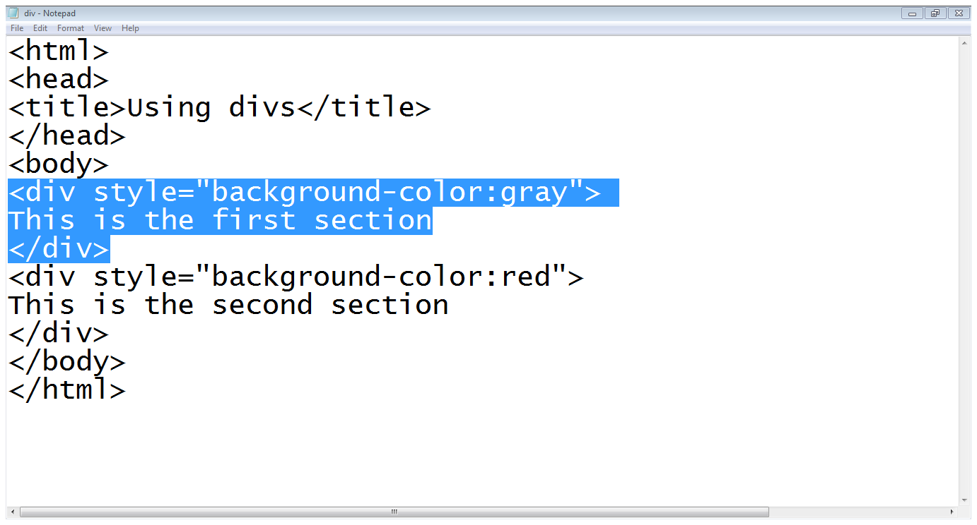
2.2 The <div> tag
Div style
Starts a div
Div contents
Div ends
Second div

Slide 20
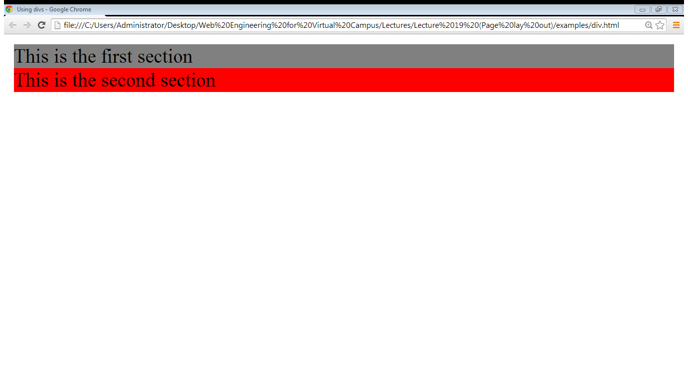
2.2 The <div> tag…
First div
Second div

Slide 21
2.3 Coding the design
<div id=“container”>
<div id=“header”>
<div id=“logo”></div>
</div> //header div ends
</div> //container div ends

Slide 22
2.3 Coding the design…
<div id=“container”>
Header and logo divs
<div id=“center-content”>
<div id=“form-containter”>
<div class=“form-heading”>
Heading text </div>
<div class=“form-rows”>
Form element </div>
</div> //form container ends
</div> //end of center content
</div> //container div ends

Slide 23
2.3 Coding the design…
<div id=“container”>
Header and logo divs
<div id=“center-content”>
Login form div’s
<div id=“form-containter”>
<div class=“form-heading”>
Heading text </div>
<div class=“form-rows”>
Form element </div>
</div> //form container ends
</div> //end of center content
</div> //container div ends

Slide 24
2.3 Coding the design…
<div id=“container”>
Header and logo divs
<div id=“center-content”>
Login form div’s
Registration form div’s
</div> //end of center content
<div id=“footer”>
</div>
</div> //container div ends

Slide 25
2.3 Coding the design…
Divs required to make the structure:
Main container
Header
Logo
Center container
Form container
Form heading
Form row

Slide 26
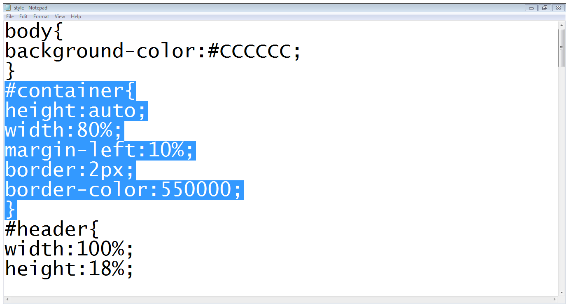
2.3 Coding the design…
Main container

Slide 27
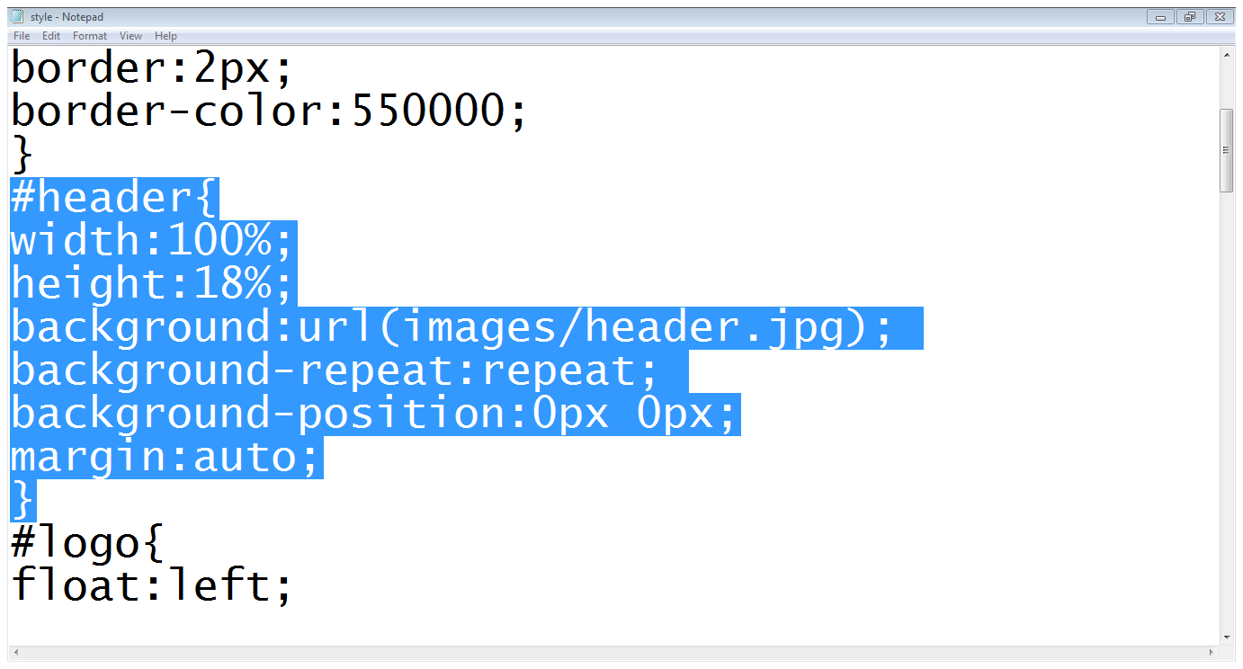
2.3 Coding the design…
Header div

Slide 28
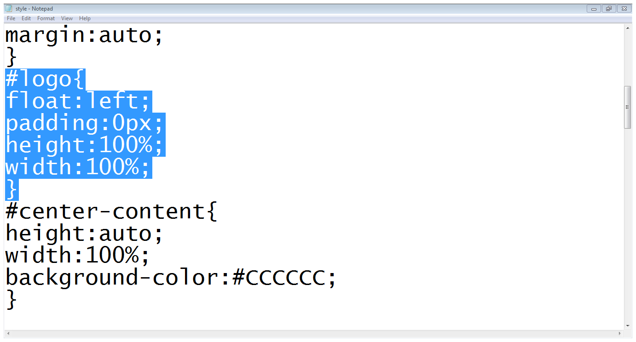
2.3 Coding the design…
Logo div

Slide 29
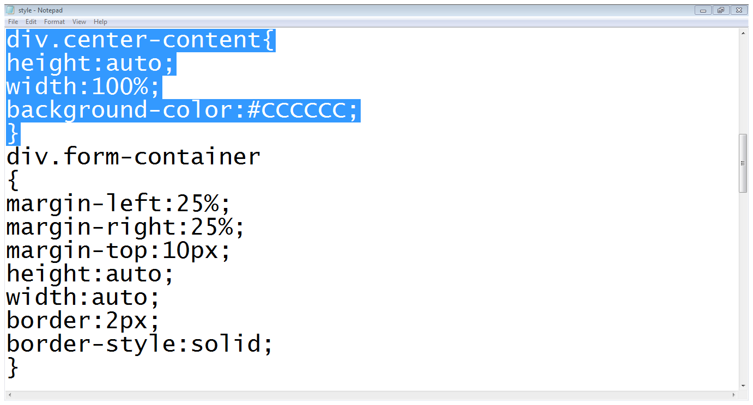
2.3 Coding the design…
Center content

Slide 30
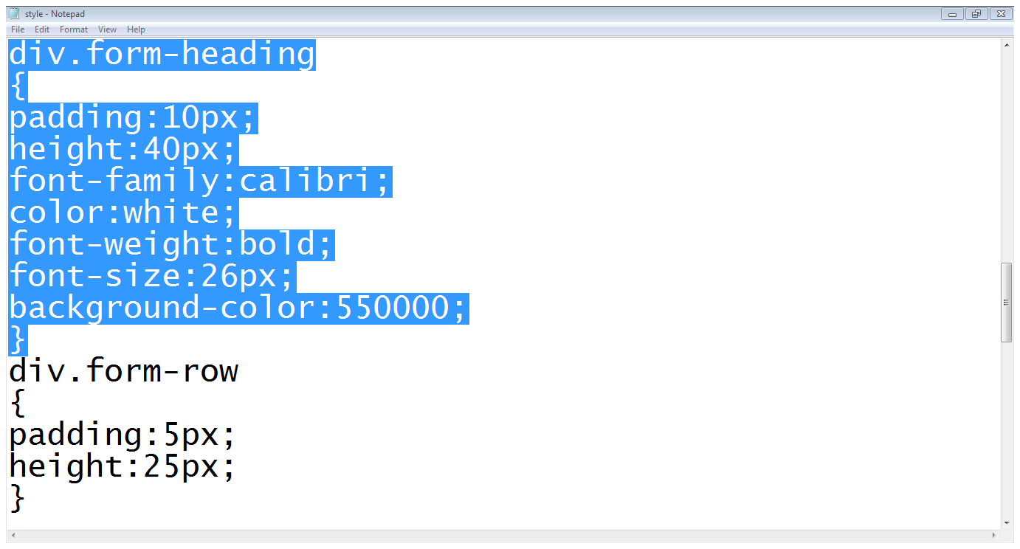
2.3 Coding the design…
Form heading
Form row

Slide 31
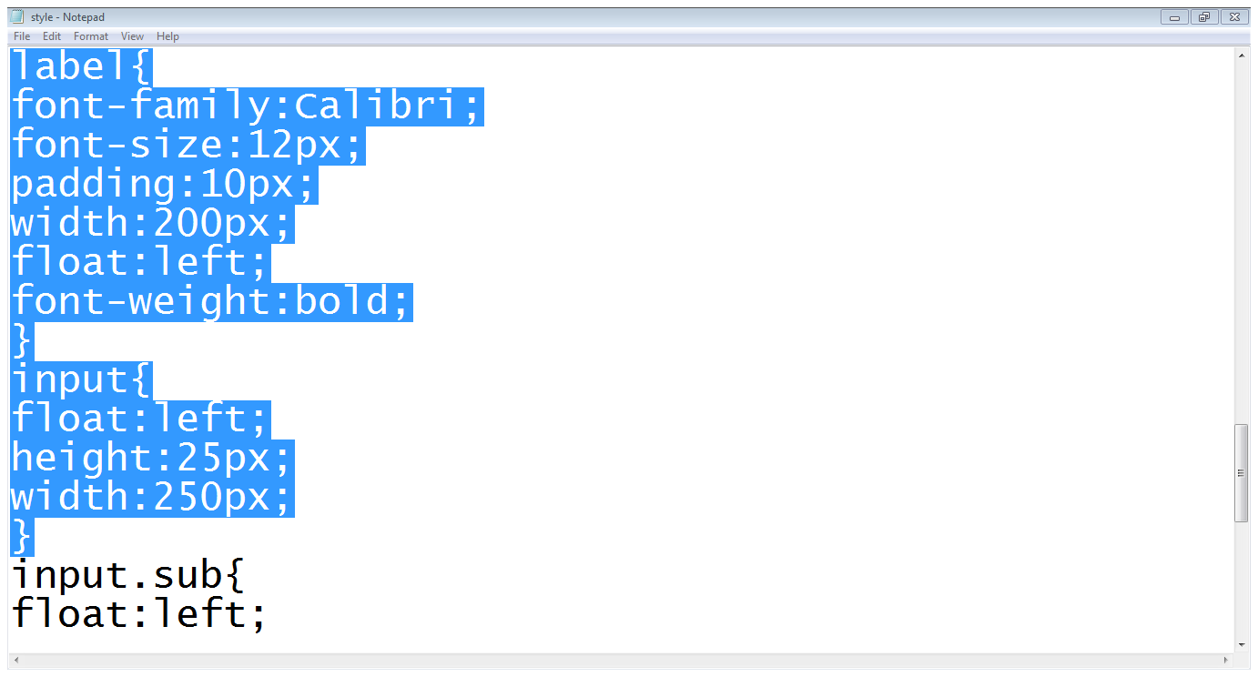
2.3 Coding the design…
Styling label
Styling input field

Slide 32
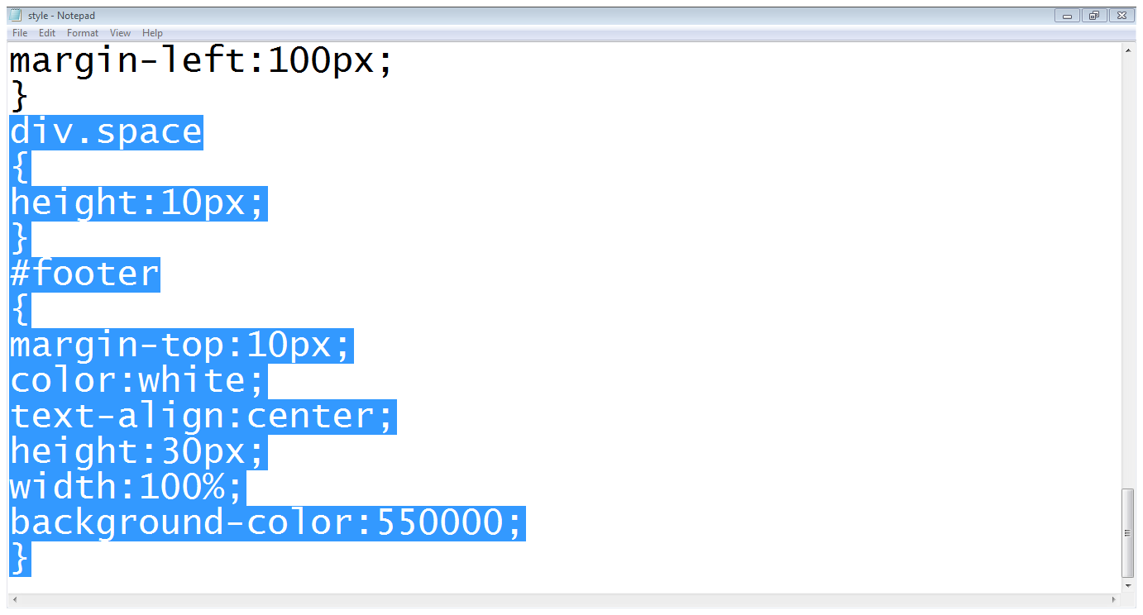
2.3 Coding the design…
Div adding space
Footer div

Slide 33
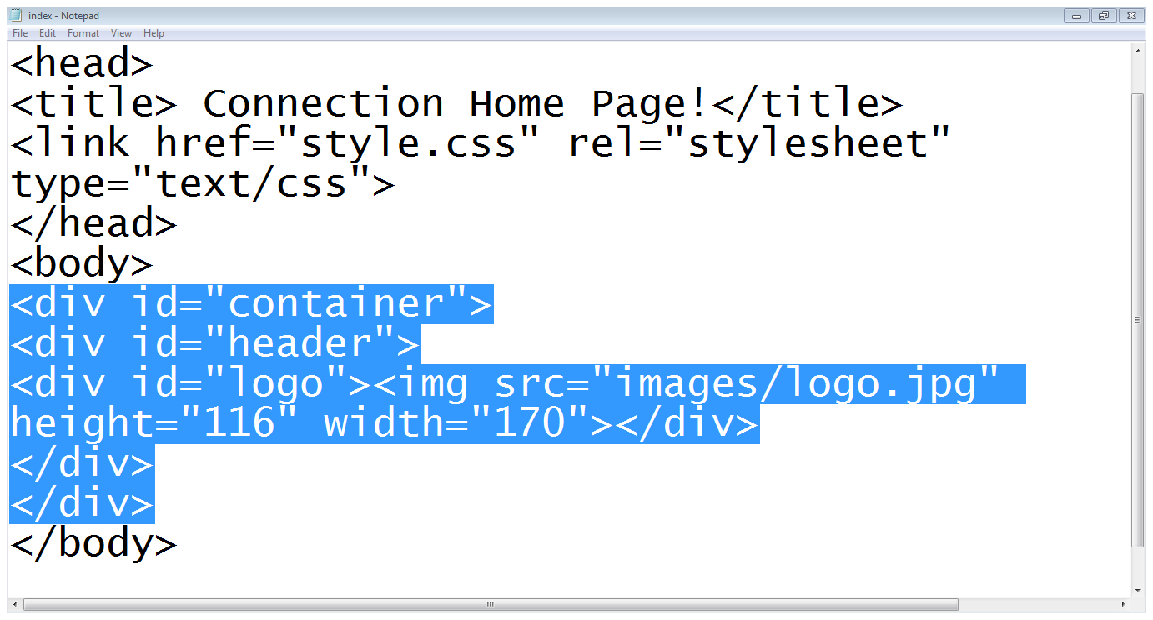
2.3 Coding the design…
Container div
Header div
Header ends
Logo div
Container ends

Slide 34
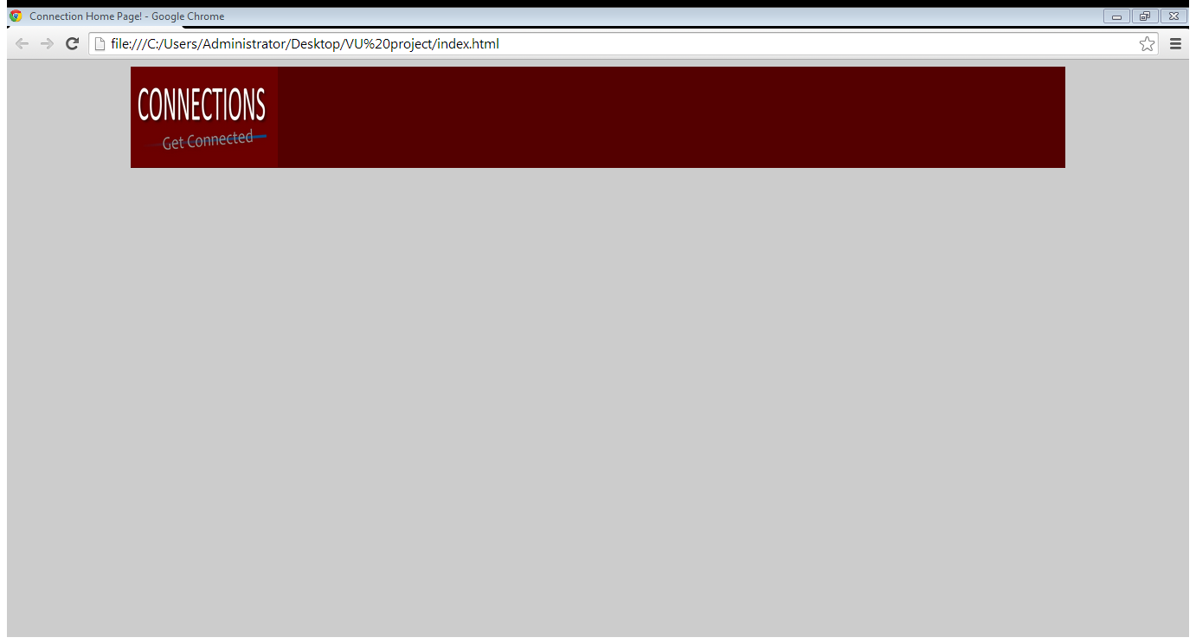
2.3 Coding the design…

Slide 35
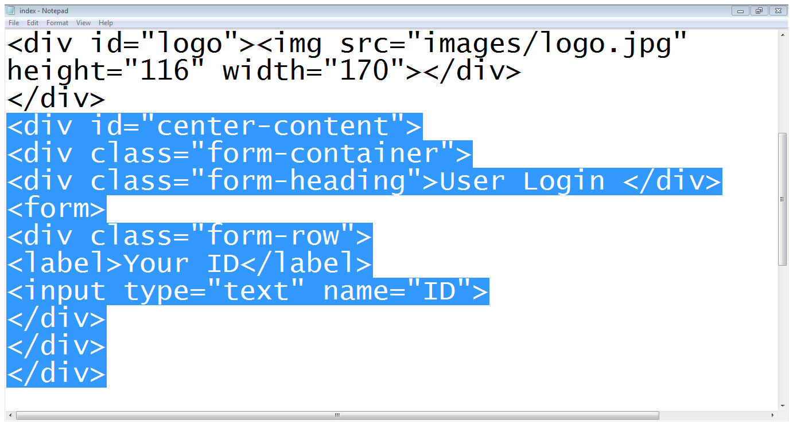
2.3 Coding the design…
Center content starts
Form container start
Form starts
Form heading
Row starts
Label
Input field
Row ends
Form container end
Center content ends

Slide 36
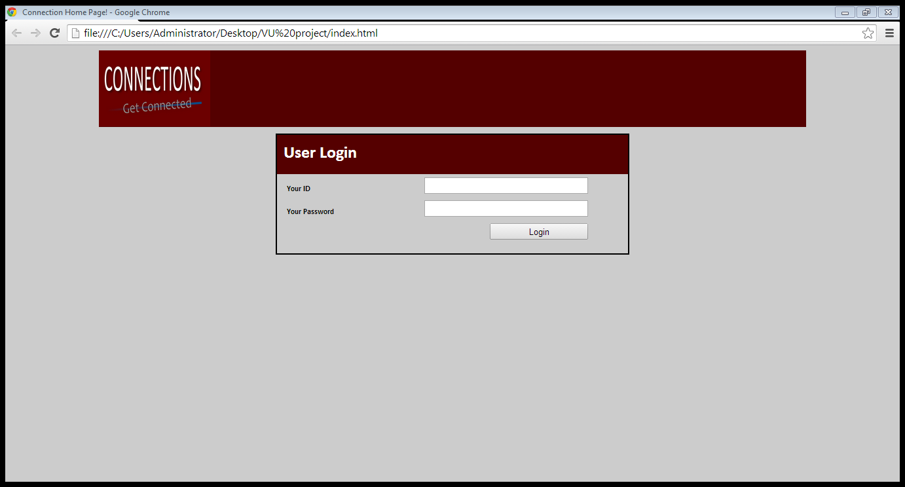
2.3 Coding the design…

Slide 37
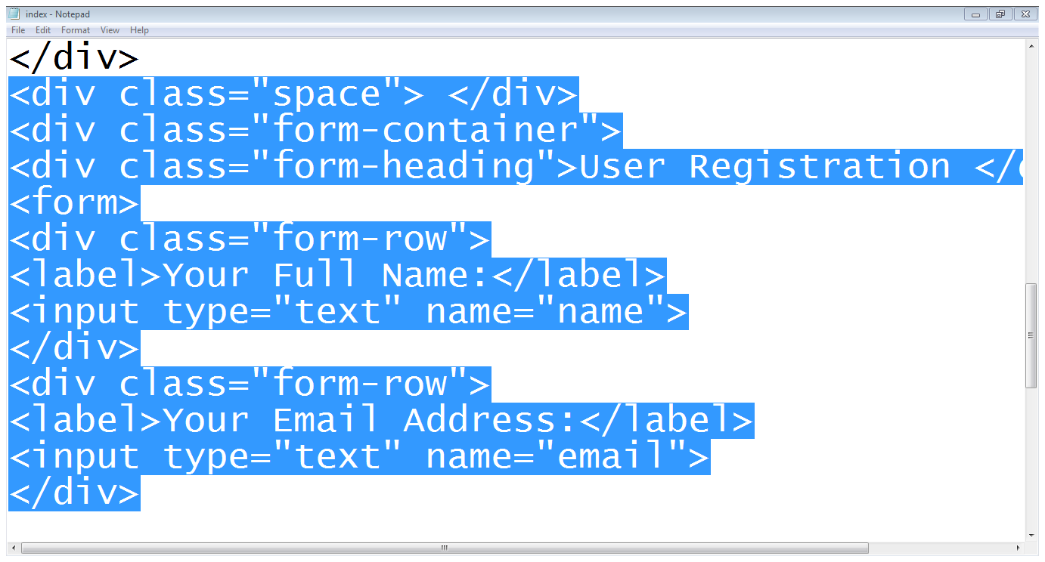
2.3 Coding the design…
Space is added
Form container
heading
Form row
Second row

Slide 38
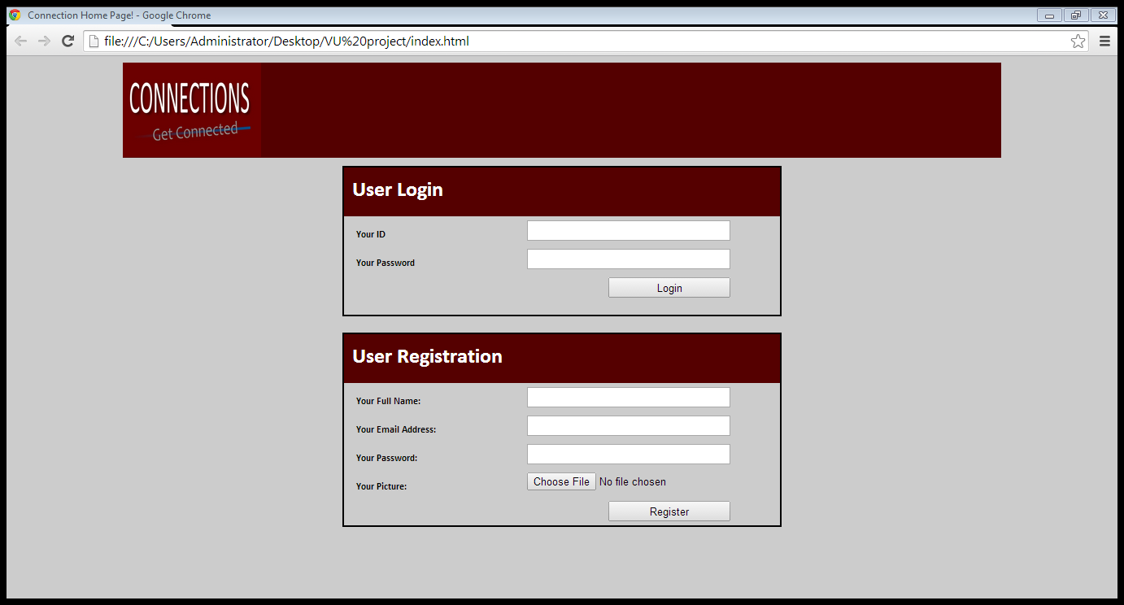
2.3 Coding the design…

Slide 39
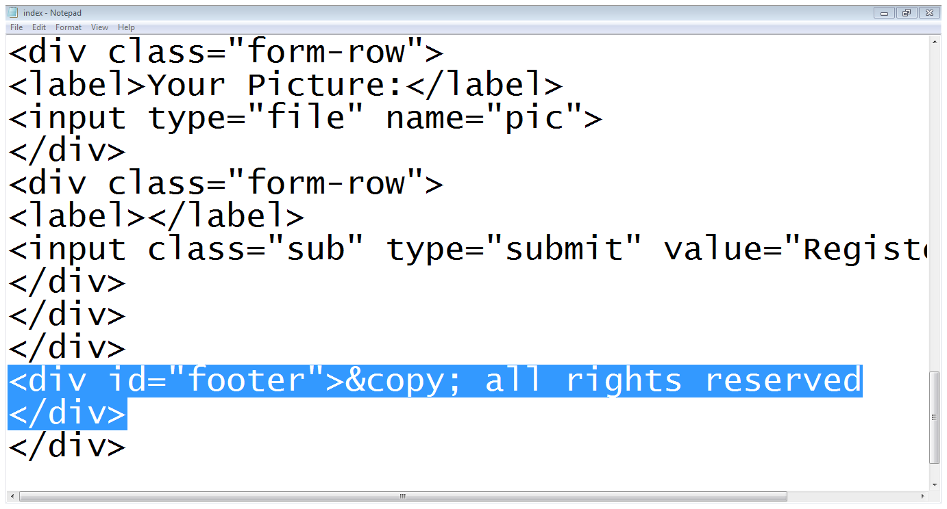
2.3 Coding the design…
Footer div

Slide 40
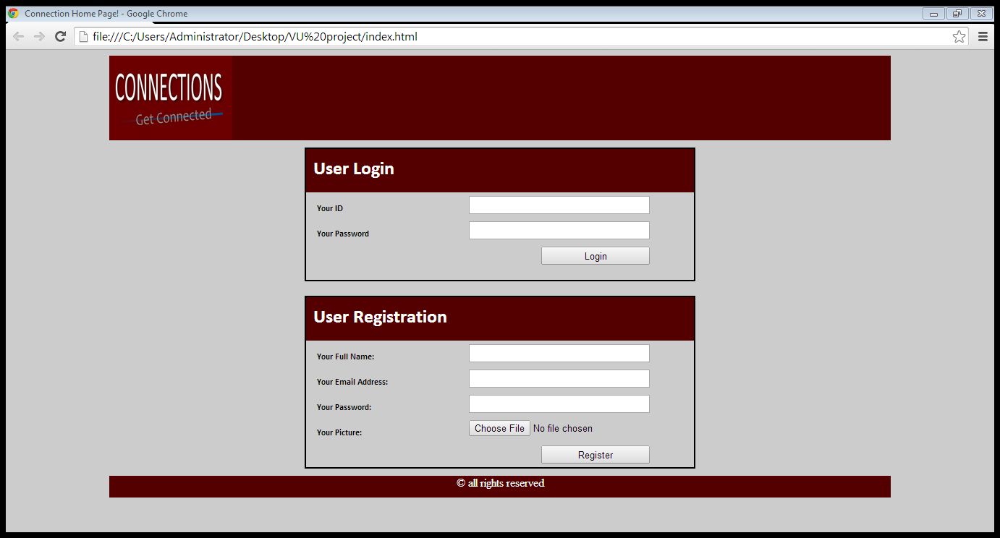
2.3 Coding the design…

Slide 41
Summary
The process to design a page layout
div tag
Coding a page using divs and CSS

Slide 42
References
Chapter 9, Beginning HTML, XHTML,CSS, and JavaScript, by Jon Duckett, Wiley Publishing; 2009, ISBN: 978-0-470-54070-1.

